Slide 1
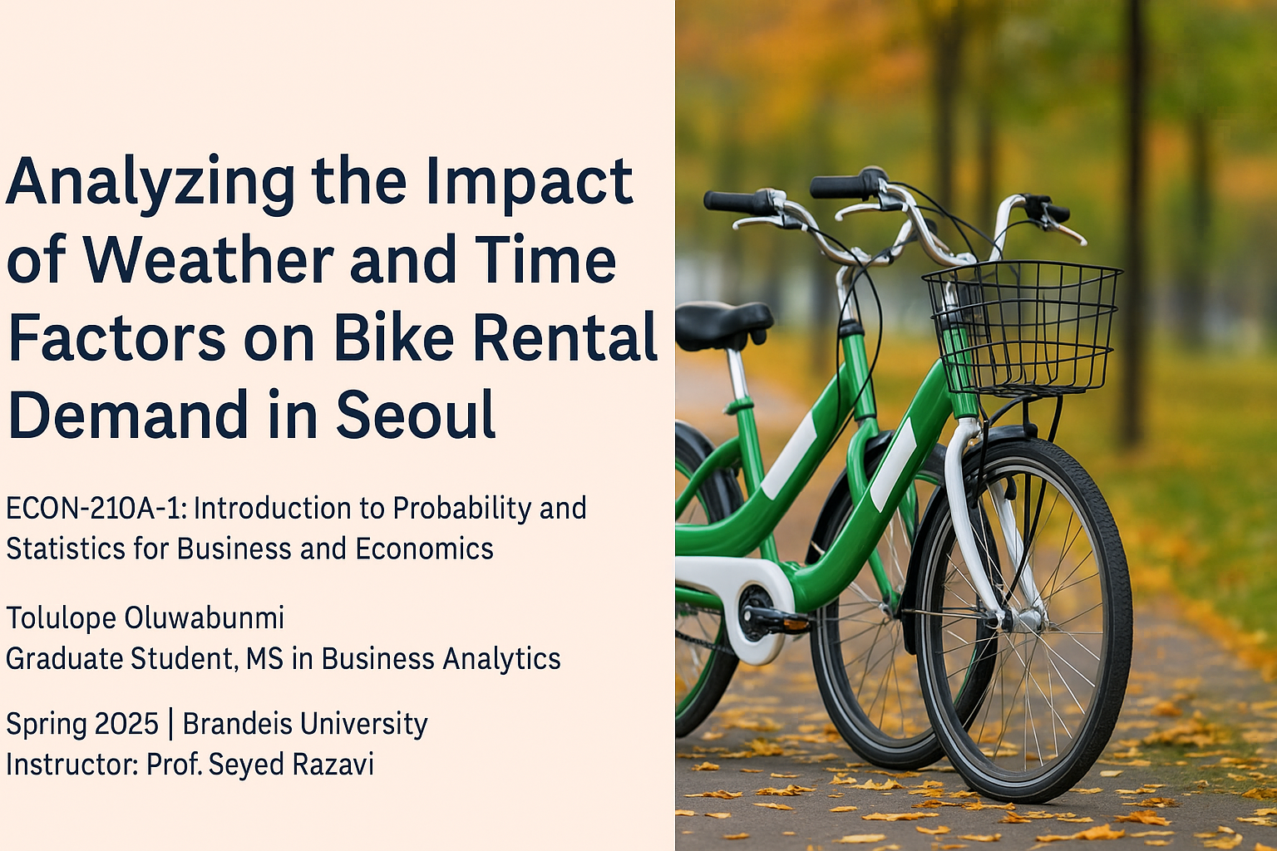

Slide 2
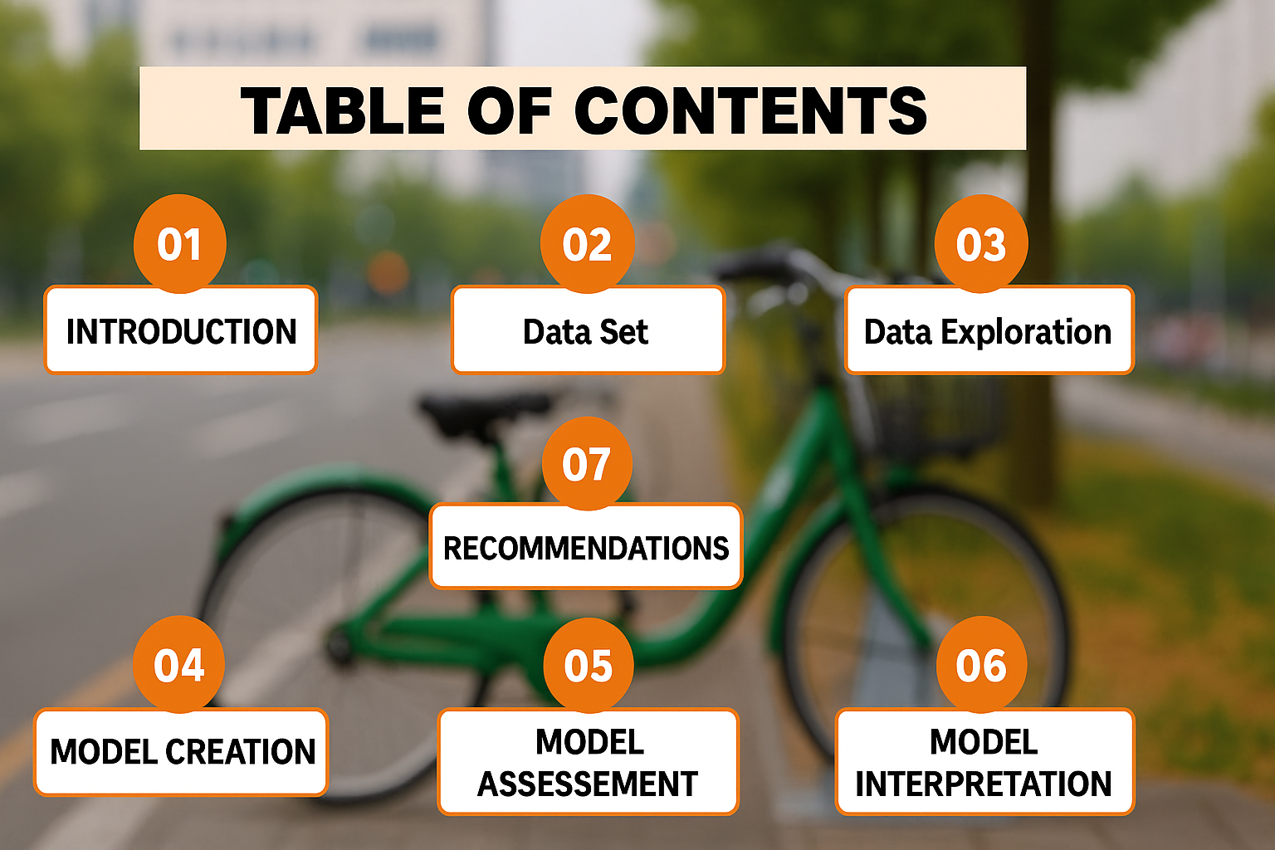

Slide 3

01
INTRODUCTION

Slide 4
Background and Context
Cities worldwide are adopting bike-sharing to address urban traffic, pollution, and public health.
Seoul, South Korea, launched a public bike-sharing system to promote micro-mobility and reduce reliance on private vehicles.
As bike-sharing grows, so does the need to understand and forecast demand patterns.
Demand is influenced by external factors like weather conditions, time of day, and holidays, which affect both operational planning and user experience.

Slide 5
The Problem and Motivation
Unpredictable demand in bike-sharing systems often leads to:
Poor bike availability
Delays during peak hours
Disruptions during weather changes
Understanding how time and weather influence usage patterns can help optimize operations and enhance user satisfaction.
This project leverages data to uncover these patterns and support smarter decision-making.

Slide 6
About This Project
This project uses a year-long, hourly dataset of Seoul bike rentals.
Multiple linear regression was applied to assess how environmental and temporal factors affect hourly rental counts.
Key variables studied are Temperature, Rainfall, Hour of day, Holiday status, Season, and Day of week.
The goal is to generate actionable insights for:
City Planners
Urban mobility researchers
Bike share operators

Slide 7
02
Data Set

Slide 8
Dataset Overview
Collected from the UCI Machine Learning Repository
Covers hourly bike rental data in Seoul for all of 2017
Contains 8,760 rows (one per hour) with weather and time-related variables

Slide 9
Variables Included in the Dataset
• Temperature (°C)
• Day of Week
• Holiday (Yes/No)
• Season (Spring, Summer, Autumn, Winter)
• Rainfall (mm)
• Hour (0–23)
Preprocessing involved encoding the ‘Holiday’ variable, creating a new column for ‘Day of Week’, and dropping highly correlated variables to address multicollinearity.

Slide 10
03
Data Exploration

Slide 11
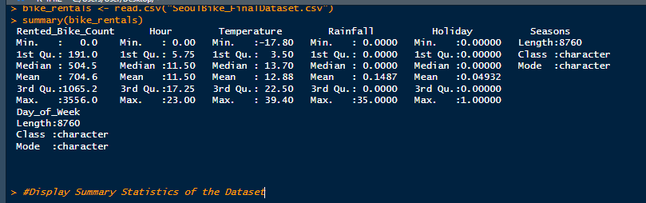
Summary Statistics

Slide 12
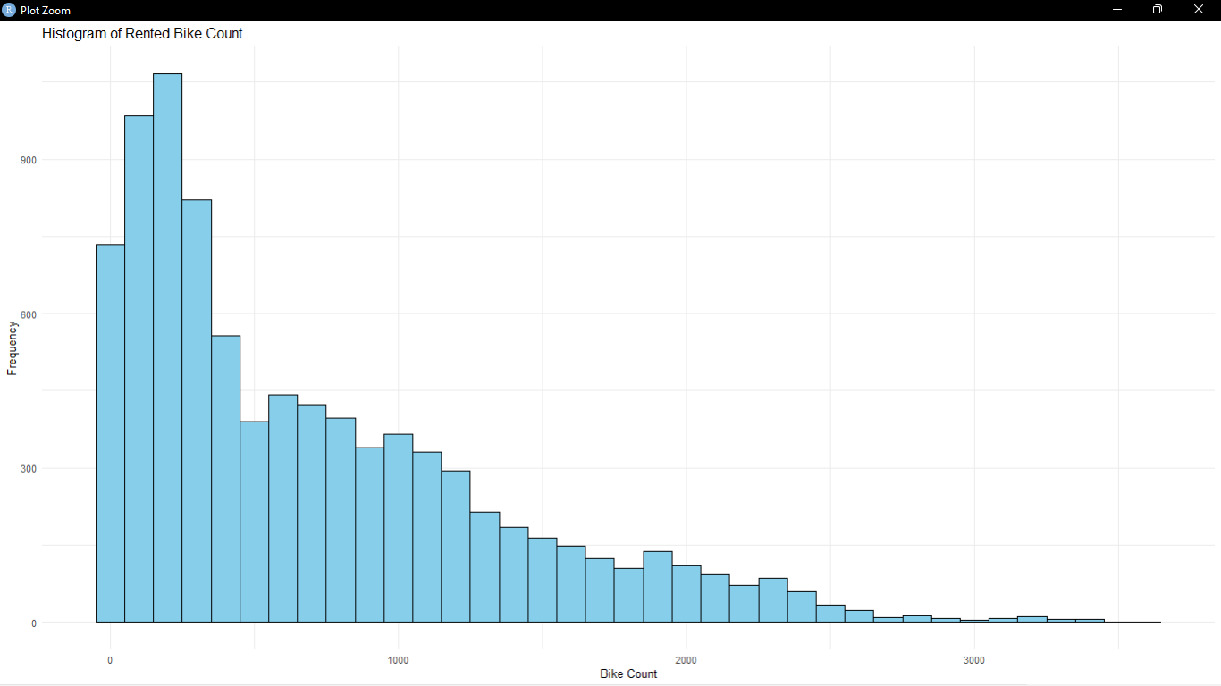
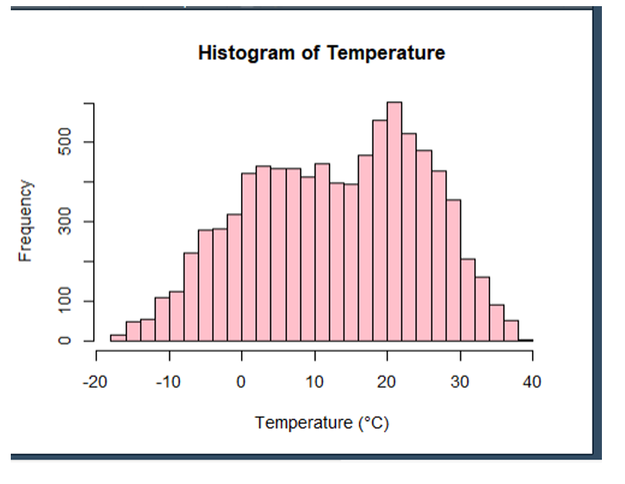
Summary Statistics - Histogram
The distribution is right-skewed, indicating a higher frequency of lower rental counts.
Most bike rental counts are below 1,000, with a few days experiencing very high rentals
The temperature distribution appears approximately normal, with most values concentrated between 0°C and 30°C.
The distribution is slightly left-skewed, reflecting more occurrences of lower temperatures in Seoul.

Slide 13
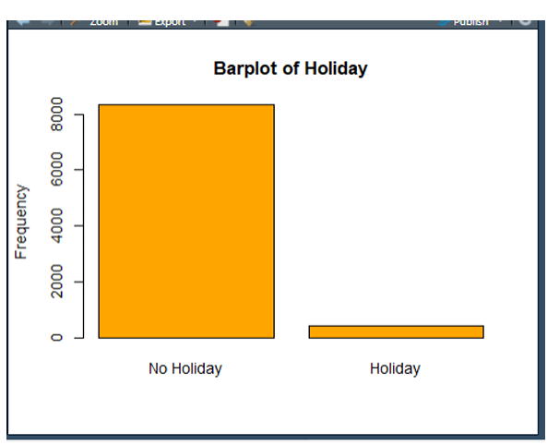
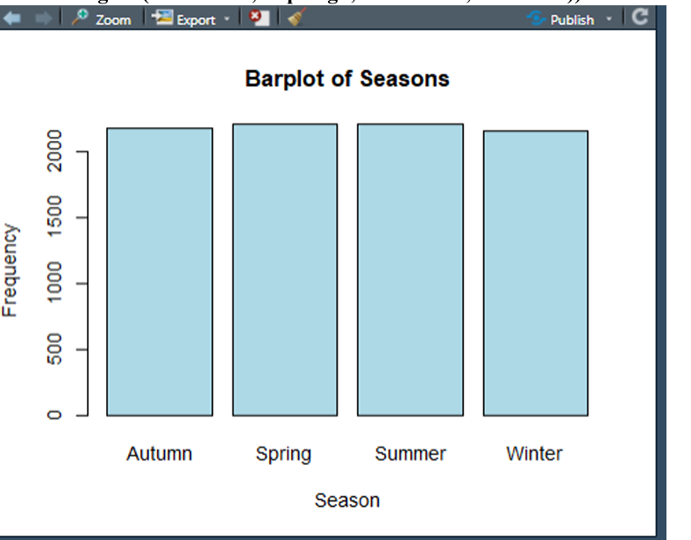
Summary Statistics - Bar plot
The majority of bike rentals occur on non-holiday days, indicating higher demand during regular days.
There is a significantly lower count of rentals on holidays, suggesting reduced activity or different travel behavior on holidays.

Slide 14
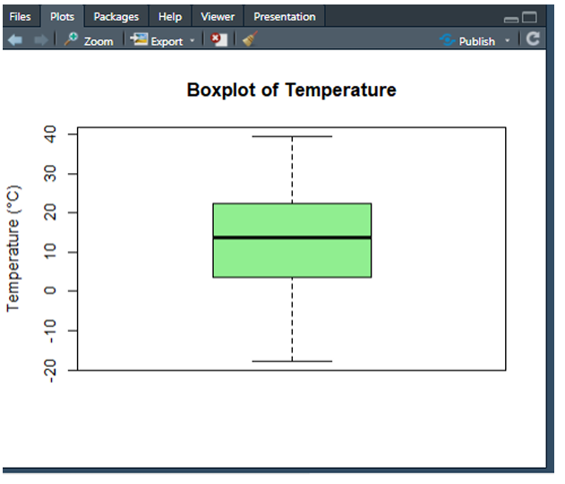
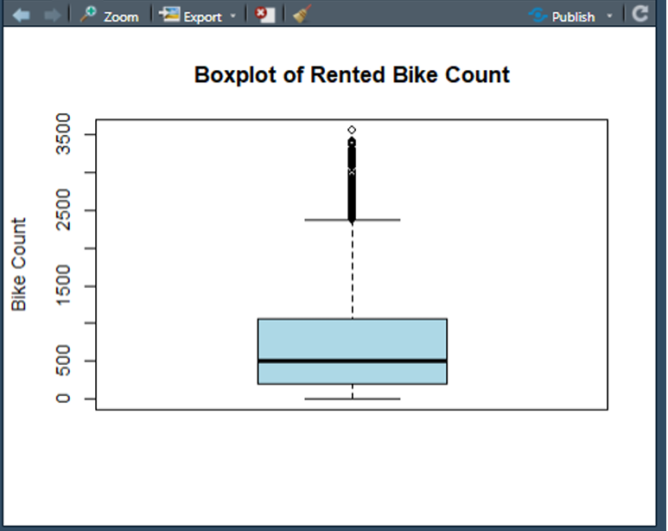
Summary Statistics - Boxplot
The temperature distribution is centered around 12-15°C, indicating a moderate climate throughout the year.
The absence of extreme outliers suggests a consistent temperature range, making it a reliable variable for analysis.
The majority of bike rentals are concentrated in the lower range, with a few high-demand instances appearing as outliers.
The presence of outliers highlights occasional spikes in bike rentals, which may be influenced by special events or favorable conditions.

Slide 15
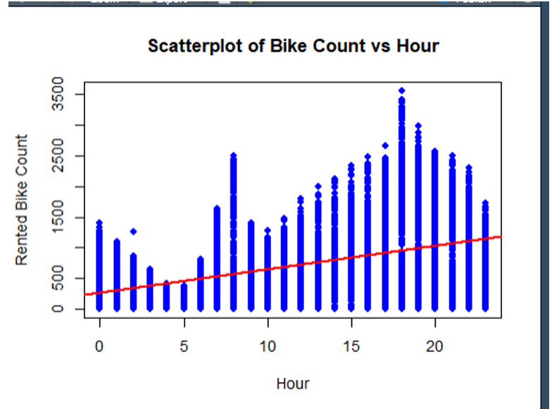
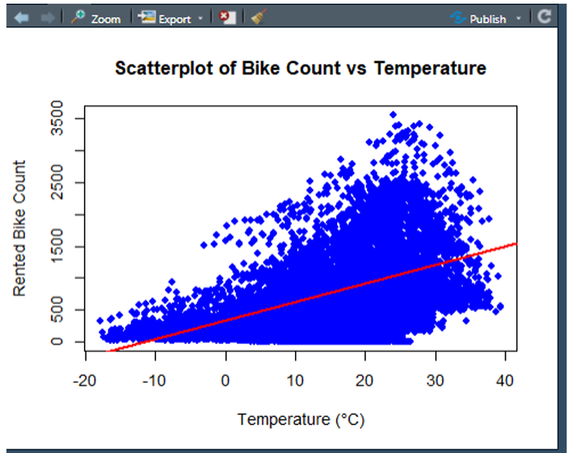
Summary Statistics – Scatter Plot
The scatter plot reveals a clear peak in bike rentals during early morning (7–9 AM) and evening (5–7 PM) hours, suggesting high demand during commute times.
The linear trend line indicates a positive relationship between time of day and bike rentals.
The scatter plot shows that bike rentals generally increase with rising temperatures, peaking around 20–25°C.
The positive linear trend suggests a strong correlation between warmer temperatures and higher bike usage.

Slide 16
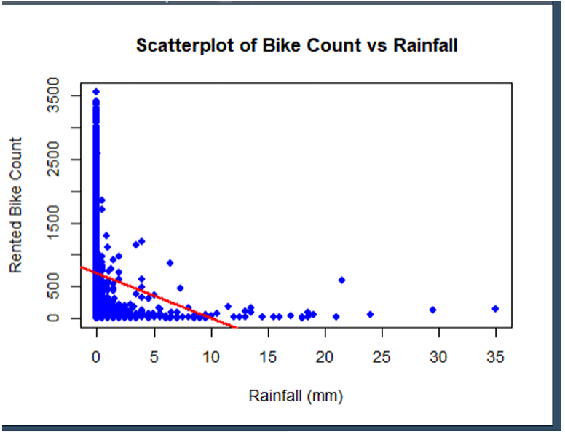
Summary Statistics – Scatter Plot
The scatter plot reveals a negative relationship between rainfall and bike rentals, indicating that as rainfall increases, the number of bike rentals decreases.
Most bike rentals occur when rainfall is minimal or zero, highlighting that wet conditions discourage users from renting bikes.

Slide 17
04
MODEL CREATION

Slide 18
Seoul Bike Rental Regression Model
Rented_Bike_Count = 181.0697 + 33.5495(Hour) +
22.4132(Temperature) - 87.6971(Rainfall) –
117.7084(Holiday) - 62.7729(Spring) –
57.7873(Summer) – 224.5915(Winter) –
20.3727(Monday) – 51.2690(Saturday) –
128.1656(Sunday) 53.4829(Thursday) –
58.4125(Tuesday) – 14.1568(Wednesday)

Slide 19
05
MODEL ASSESSMENT

Slide 20
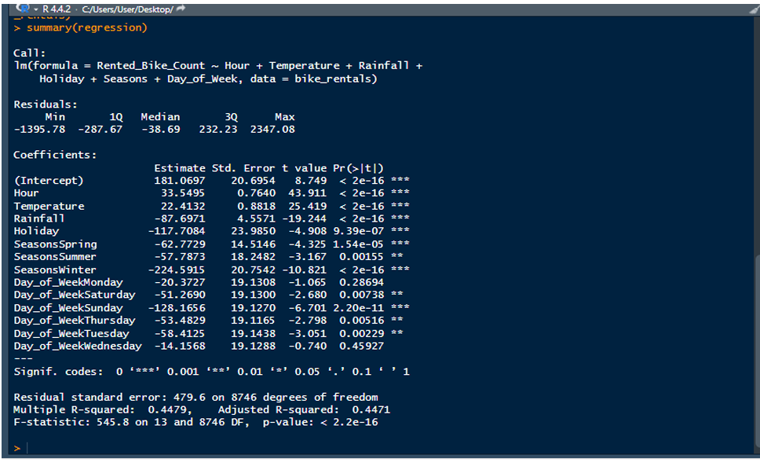
Regression Model Summary

Slide 21
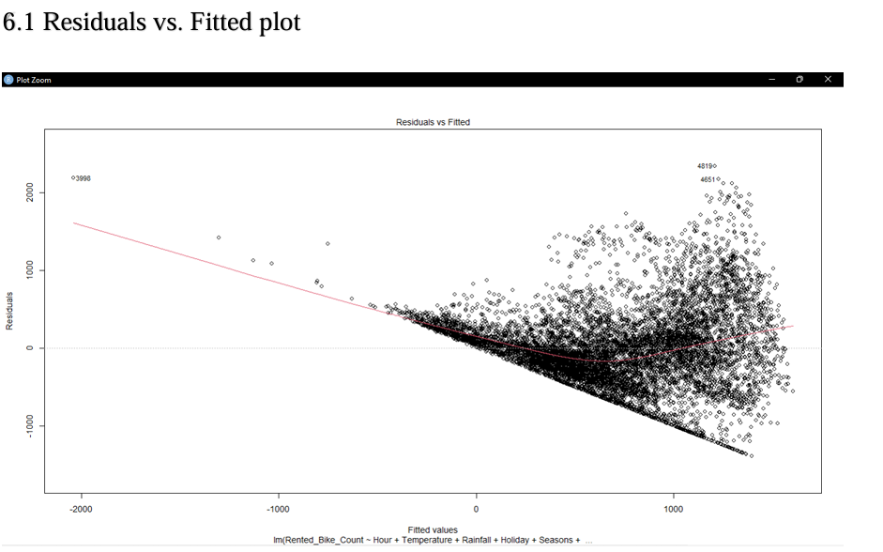
Residuals vs Fitted plot
The plot shows a general pattern with some degree of curvature, suggesting non-linear in the model.
The spread of residuals increases slightly at higher fitted values, indicating potential variability in prediction accuracy.

Slide 22
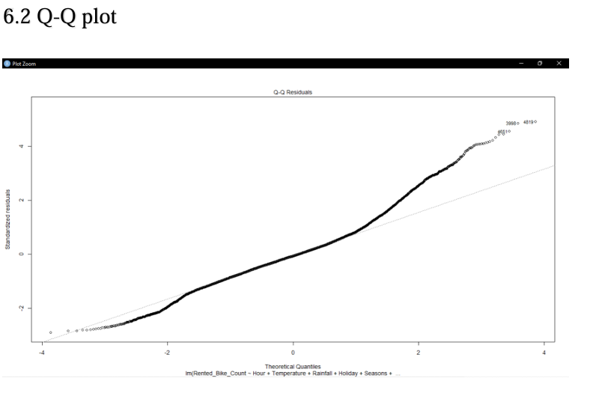
Q-Q plot
The Q-Q plot compares the distribution of residuals to a theoretical normal distribution.
A slight deviation from the straight line suggests some departure from normality, especially at the tails.
While the plot indicates minor deviations, the overall trend aligns reasonably well with the normal distribution.

Slide 23
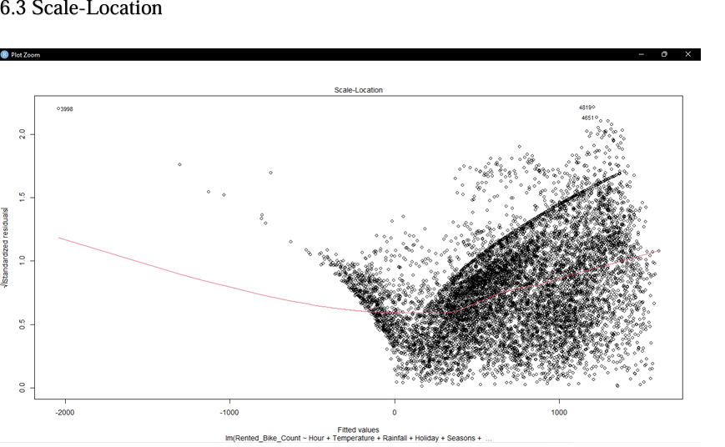
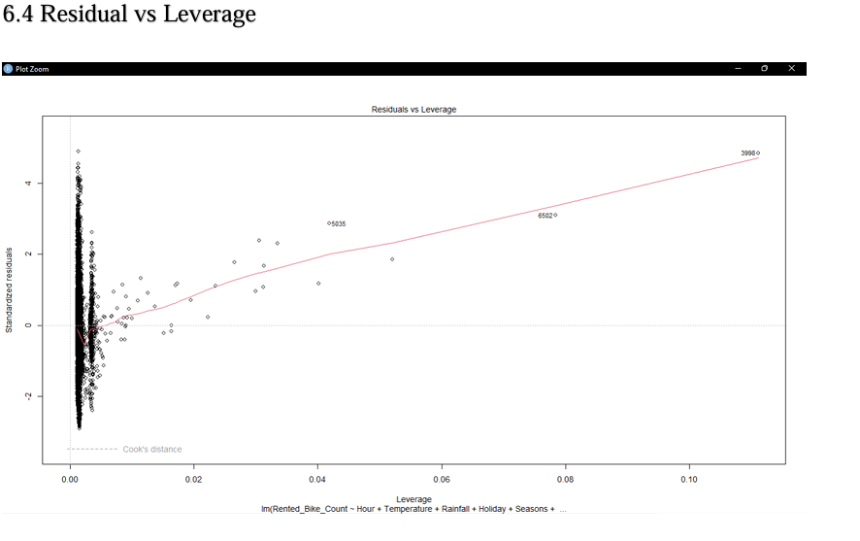
Scale-Location and Residual vs Leverage
The Scale-Location plot shows a gradual increase in the spread of residuals, suggesting slight variability in prediction accuracy across fitted values.
The slight curvature hints at a possible non-linear relationship, which may benefit from further exploration.
The Residuals vs Leverage plot highlights a few data points with higher influence, suggesting they may have a stronger effect on the model’s predictions.
Monitoring these points can help ensure the model remains reliable and balanced.

Slide 24
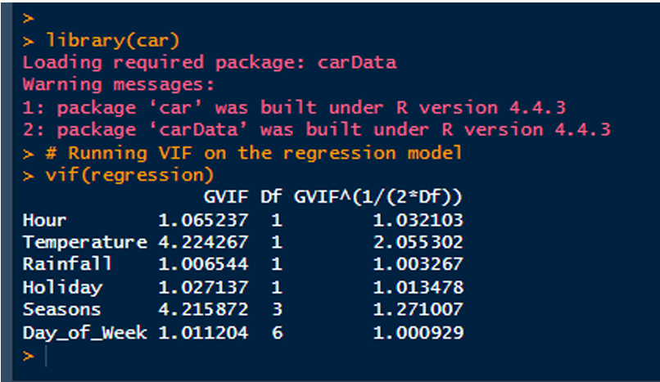
Collinearity
The Variance Inflation Factor (VIF) values are generally below 5, indicating that multicollinearity is not a significant concern for all variables in this model.

Slide 25
06
MODEL INTERPRETATION

Slide 26
Model Interpretation
The model produced an R-squared value of 0.4479, indicating that approximately 45% of the variation in bike rentals is explained by the included variables. The F-statistic of 545.8 with a p-value less than 2.2e-16 confirms that the model is statistically significant.
The intercept (β₀ = 181.07) represents the estimated number of bikes rented when all predictors are at their reference levels—for example, at hour 0, with a temperature of 0°C, no rainfall, a non-holiday, and during the reference season and weekday.
The coefficient for Hour (β₁ = 33.55, p < 0.001) shows a strong positive effect, indicating that each additional hour in the day leads to an average increase of approximately 33.55 bike rentals.

Slide 27
Model Interpretation Cont’d
Temperature (β₂ = 22.41, p < 0.001) also has a positive impact. A one-degree Celsius increase in temperature results in an estimated increase of 22.41 bike rentals per hour.
Rainfall (β₃ = -87.70, p < 0.001) has a significant negative effect. For each additional millimeter of rainfall, the number of bike rentals is expected to decrease by approximately 87.70.
Holiday status (β₄ = -117.71, p < 0.001) also negatively affects rentals. On holidays, the number of bikes rented is expected to decrease by roughly 118 compared to No Holidays.

Slide 28
Model Interpretation Cont’d
With respect to Season (with Autumn as the reference category), other seasons showed statistically significant reductions in rentals:
Spring: β = -62.77 (p < 0.001), Summer: β = -57.79 (p = 0.0015), Winter: β = -224.59 (p < 0.001)
Regarding Day of the Week, compared to Friday:
Saturday: β = -51.27 (p = 0.007)
Sunday: β = -128.17 (p < 0.001)
Tuesday: β = -58.41 (p = 0.002)
Thursday: β = -53.48 (p = 0.005
Monday and Wednesday did not show statistically significant differences in rental activity compared to the reference day.

Slide 29
07
RECOMMENDATIONS

Slide 30
RECOMMENDATIONS
Dynamic Fleet Management:
Optimize bike distribution during peak hours (7–9 AM, 5–7 PM) for better commuter service.
Adjust bike availability based on hourly demand trends.
Weather-Responsive Operations:
Use weather forecasts to predict demand and offer incentives during rainy or winter days.
Implement discounted rides or extended return times to maintain usage.
Seasonal Marketing Campaigns:
Launch promotional campaigns during low-demand seasons, such as winter.
Offer weather-adapted bikes, safety tips, and subscription discounts to attract users.

Slide 31
RECOMMENDATIONS
Infrastructure Planning:
Prioritize building covered docking stations in high-usage areas affected by weather.
Develop sheltered bike lanes to ensure consistent accessibility.
Weekend and Holiday Strategy:
Promote bike usage for leisure with targeted offers on weekends and holidays.
Highlight family rides, tourism routes, and fitness tracking partnerships.
Data-Driven Policy Making:
Use data insights to guide government and non-profit investments in cycling infrastructure.
Justify green transit initiatives with clear usage patterns.

Slide 32
RECOMMENDATIONS
Maintenance Optimization:
Schedule routine maintenance during low-demand periods (early mornings, rainy days, winter).
Ensure bikes are available and well-maintained during peak hours.

Slide 33


Slide 34
THANK YOU
For your attention!

